Slide 1
LOCAL FINDER
Presented by:-
Yogesh K Yadav B047,
Nimesh Panchal B057,
Pratik Telang B060,
Prakhar Goyal B063

Slide 2
INTRODUCTION
Our app local finder is created with the intent to help drivers to find parking places and fuel and various other commodities in an instant thus making owning a vehicle more easy
Our local finder app at this stage of development can display parking areas and fuel stations using the a user given pin code and then selecting the commodity which you want to see

Slide 3
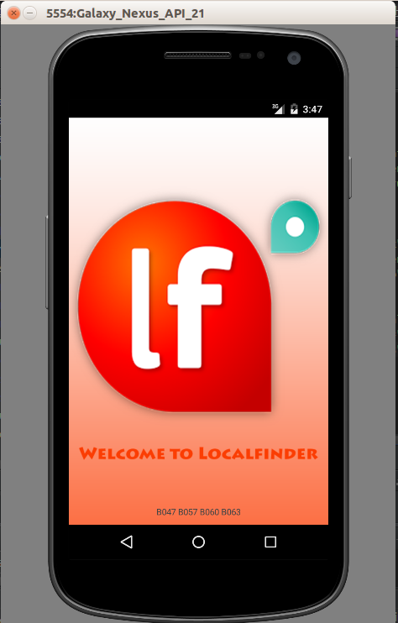
Welcome screen implemented
using splash screen concept .

Slide 4
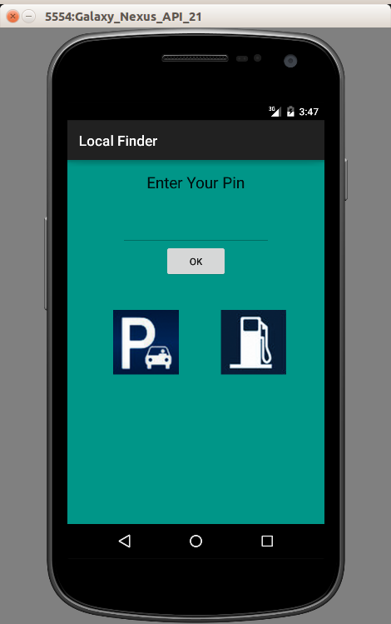
MainActivity – Home Screen
Our Home Screen => Once you open the app home screen will appear as shown in the screenshot where it will contain Area pin code, Parking & Fuel Stations.
Enter the Area
Pin Code here
Parking
Fuel Stations

Slide 5
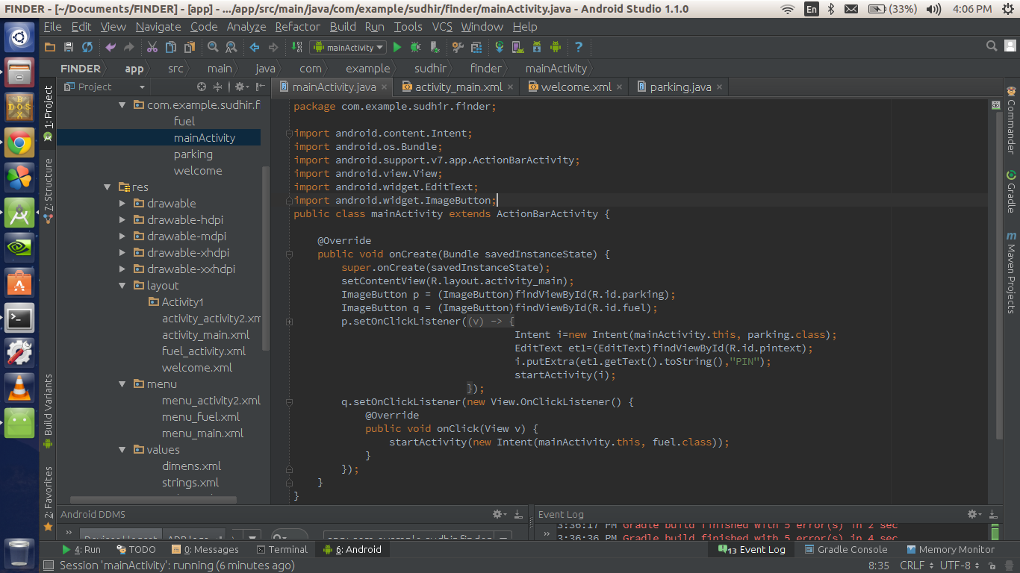
MainActivity.Java

Slide 6
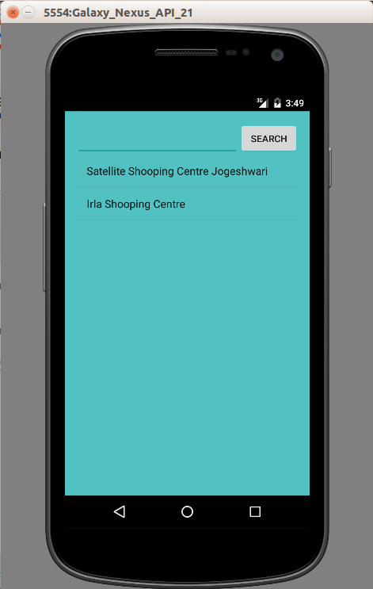
PARKING LOCATIONS
Once you enter the Area pin code and select parking button , you will be displayed with all the parking locations of that local area. (As shown in screen-shot)

Slide 7
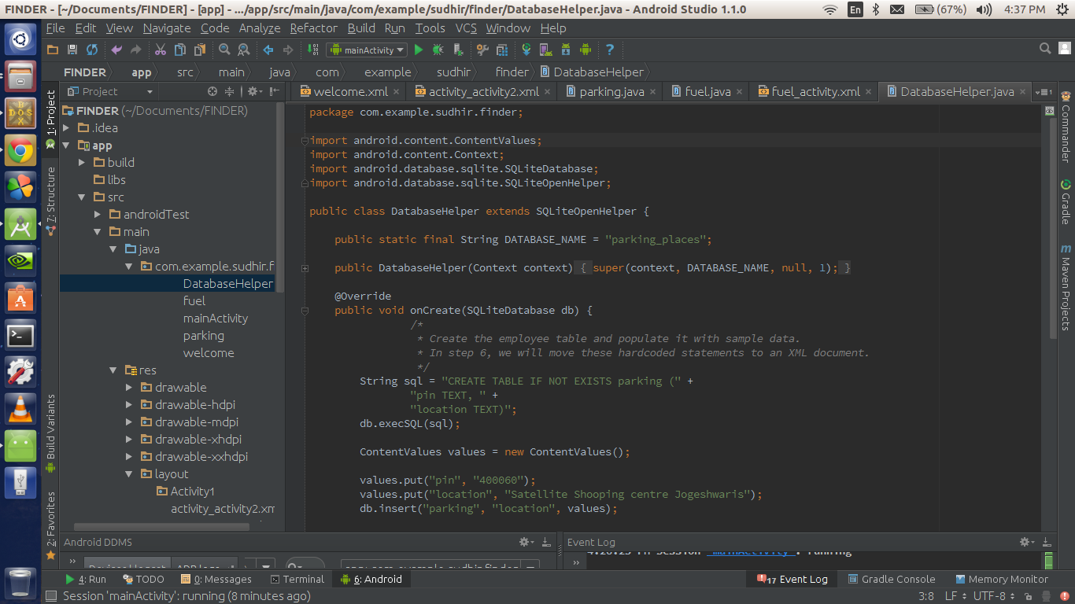

Slide 8
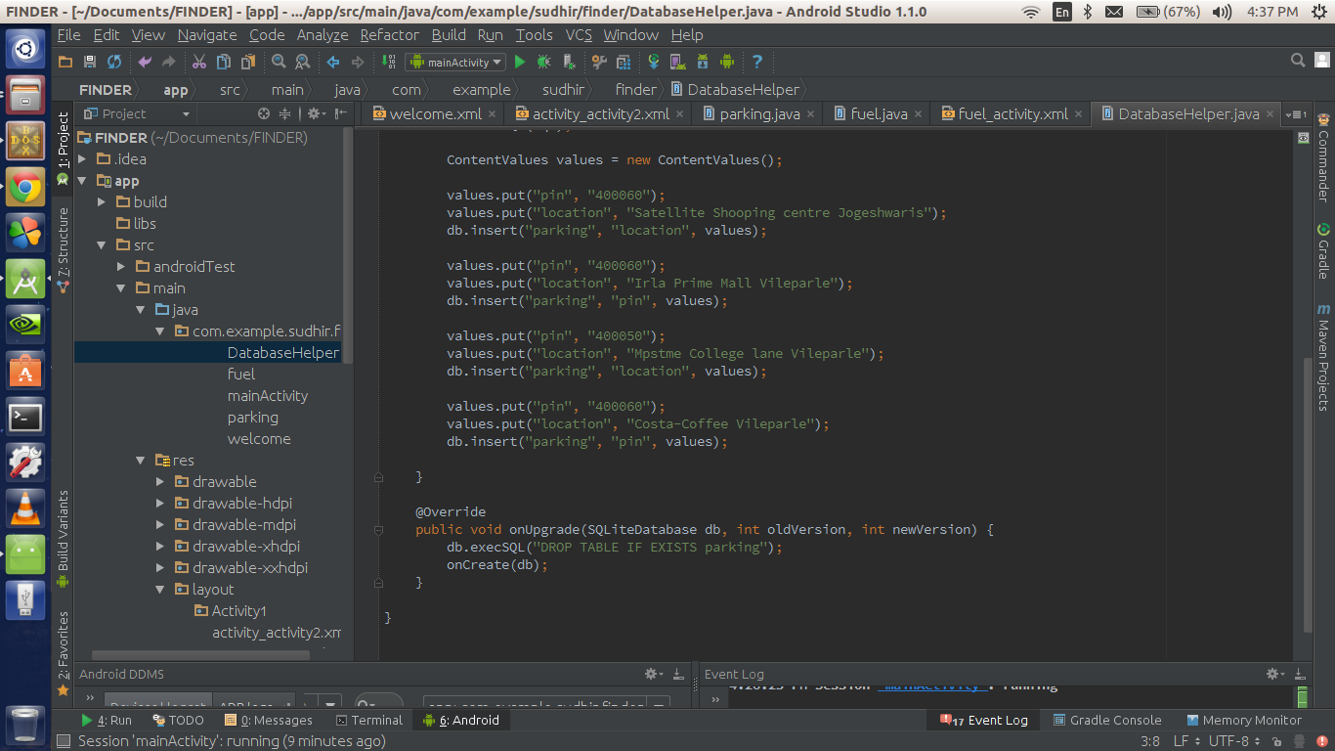

Slide 9
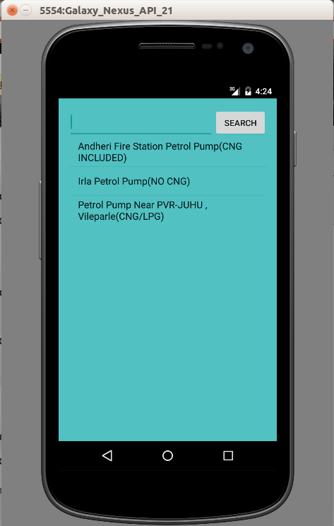
FUEL STATIONS
Once you enter the Area pin code and select Fuel Station button , you will be displayed with all the Fuel Station locations of that local area. (As shown in screen-shot)

Slide 10
Future scope
Currently user can search within the limitations of Ville Parle and Andheri. But in future we are planning of incorporating the whole city of Mumbai, and thereafter India
Our app is currently offline ,this limits the amount of data that can be accessed and also increases the size of the app, thus for this we are going to integrate online databases to further increase the usefulness of the app

Slide 11
We would also add more functionalities like:-
Hospitals
Atms
Public libraries
Blood banks
Tourist attractions
Libraries

Slide 12
THANK YOU !!

